Slide 1
Bayesian Optimization on Graphs
Keyue Jiang
2023/07/04

Slide 2
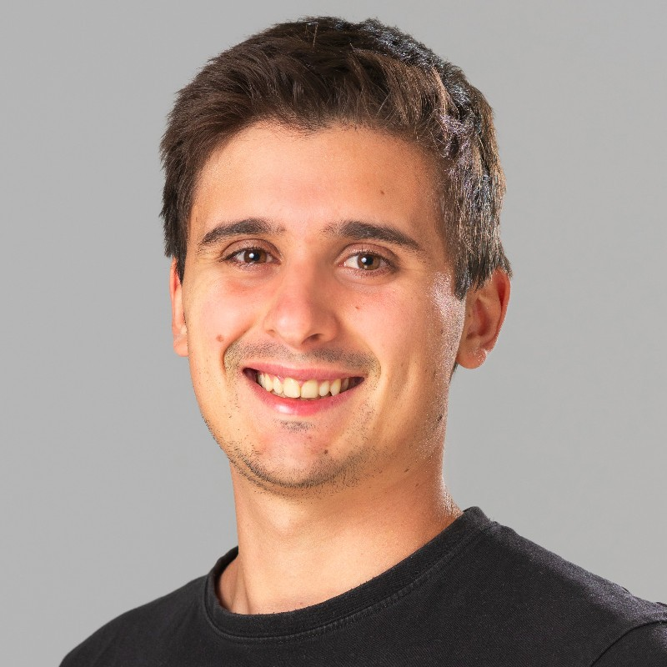
Special thanks to

Slide 3

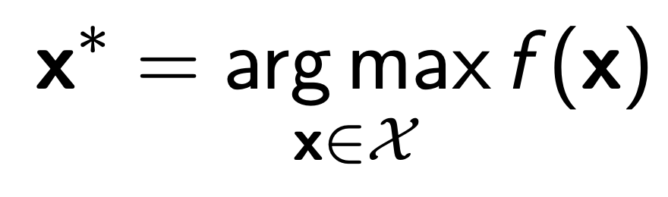
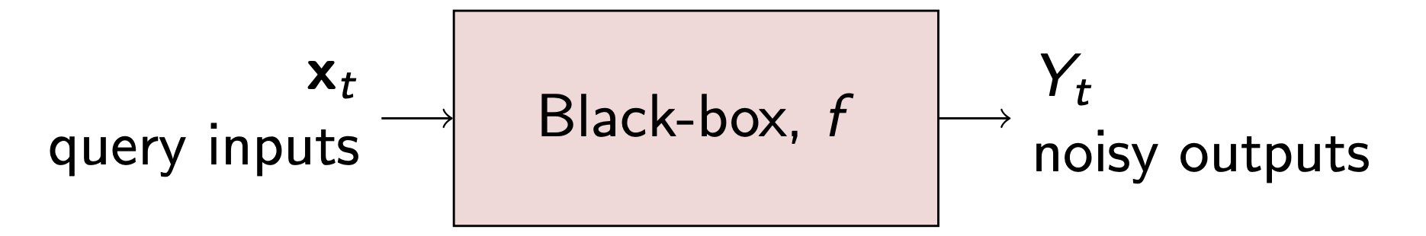
Bayesian Optimization
The Goal
Optimize a black-box function
The function is:
No gradient, corrupted by noise
Each Query is expensive (e.g. Neural Architecture Search, Molecule Design, Drug Discovery)

Slide 4
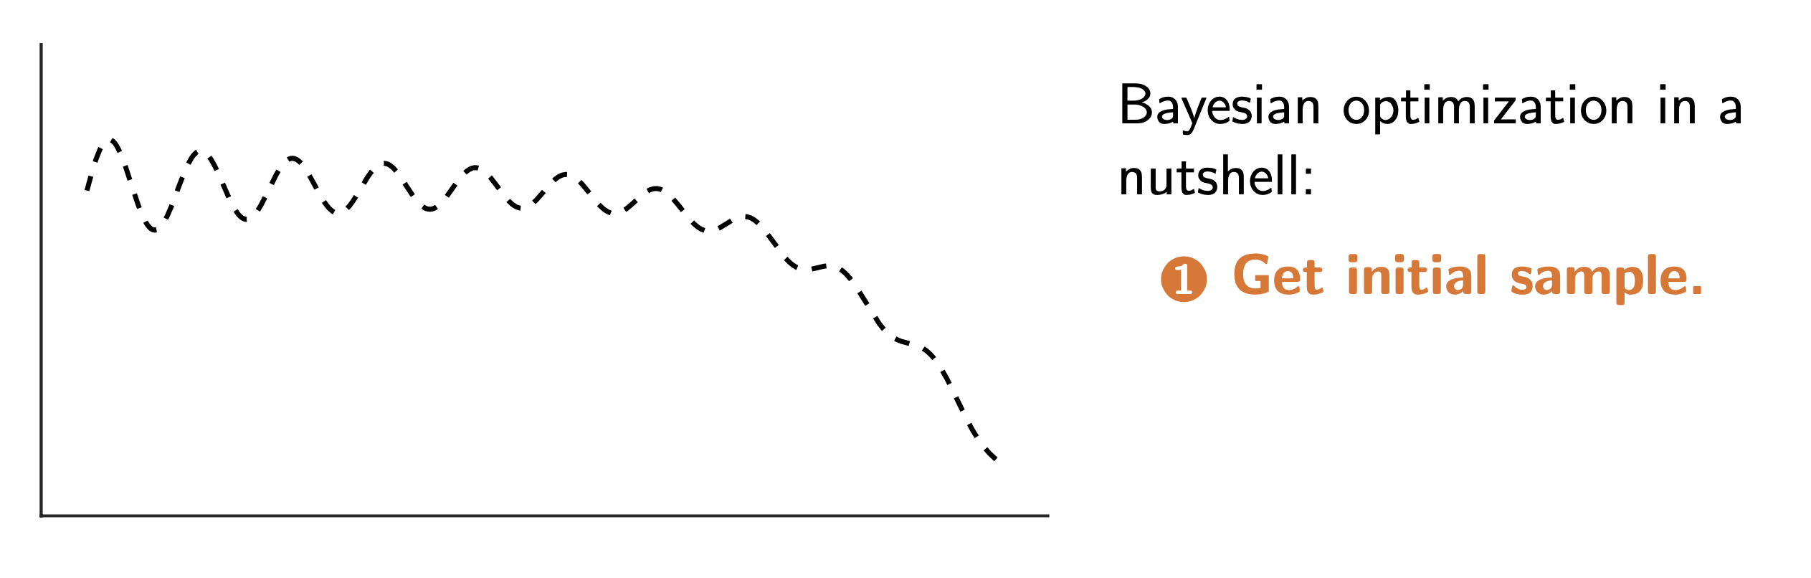
Bayesian Optimization
Figures credited to Miguel Hern ́andez-Lobato

Slide 5
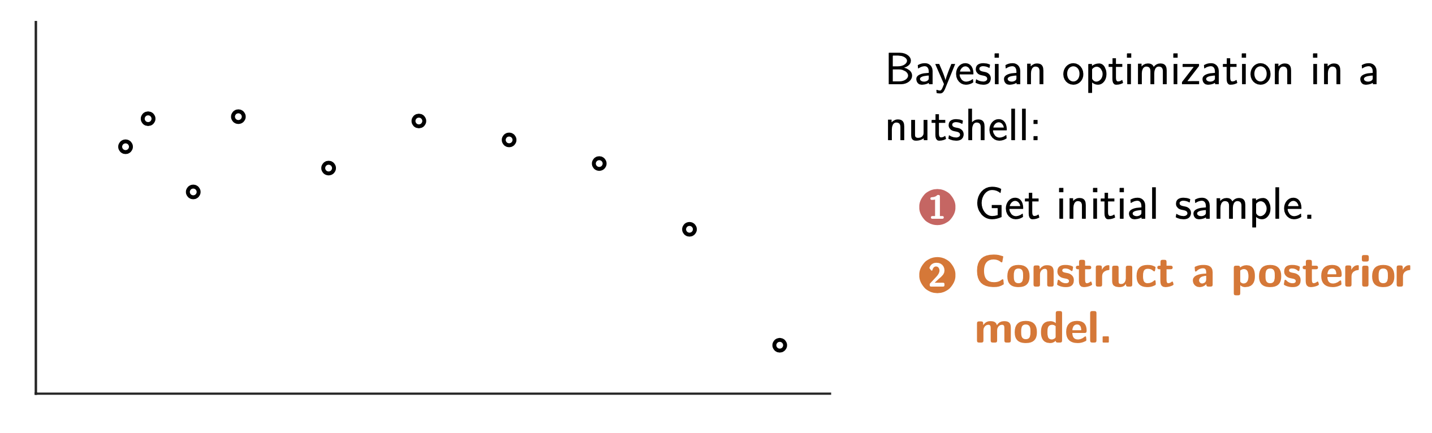
Bayesian Optimization
Figures credited to Miguel Hern ́andez-Lobato

Slide 6
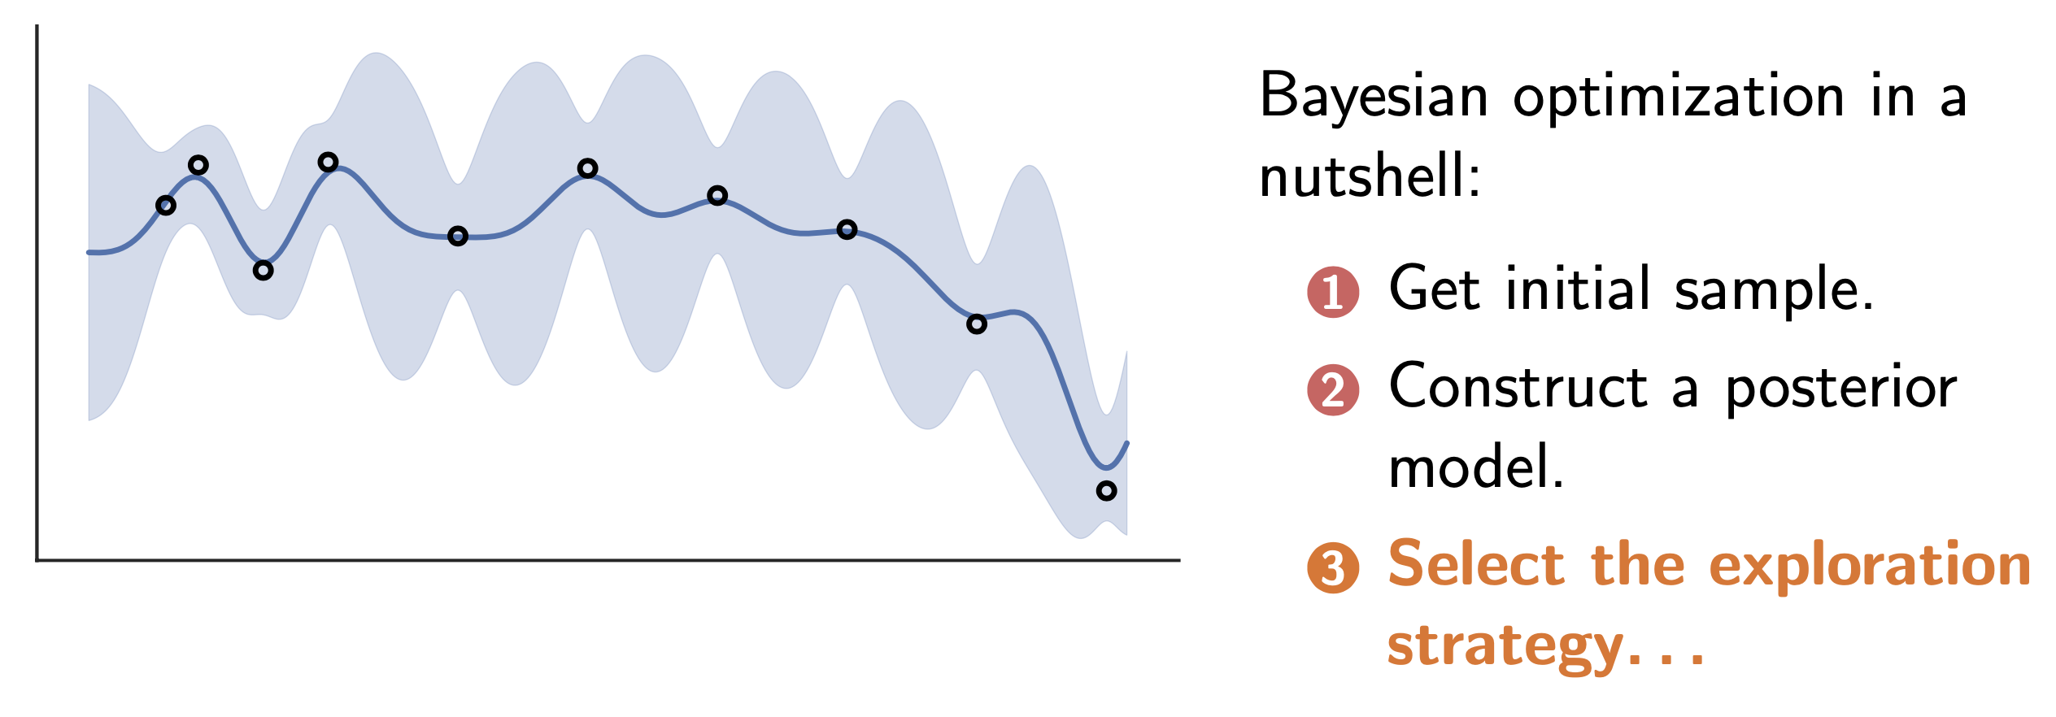
Bayesian Optimization
Figures credited to Miguel Hern ́andez-Lobato

Slide 7
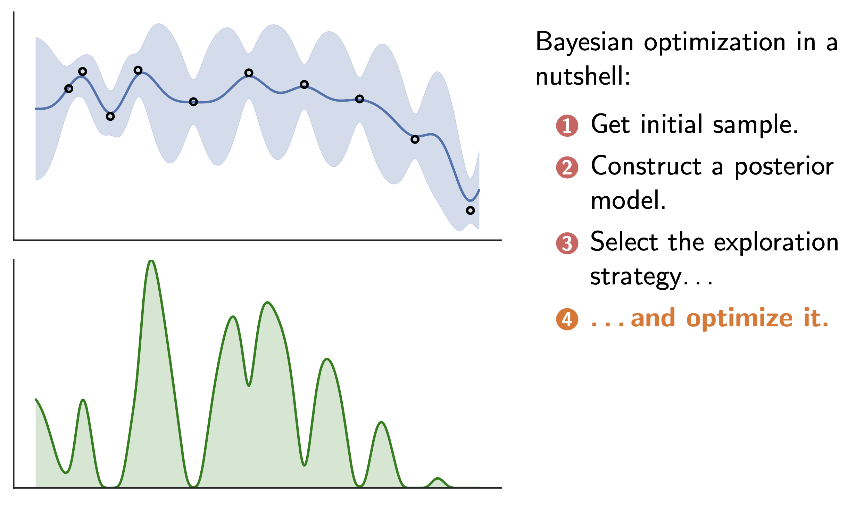
Bayesian Optimization
Figures credited to Miguel Hern ́andez-Lobato

Slide 8
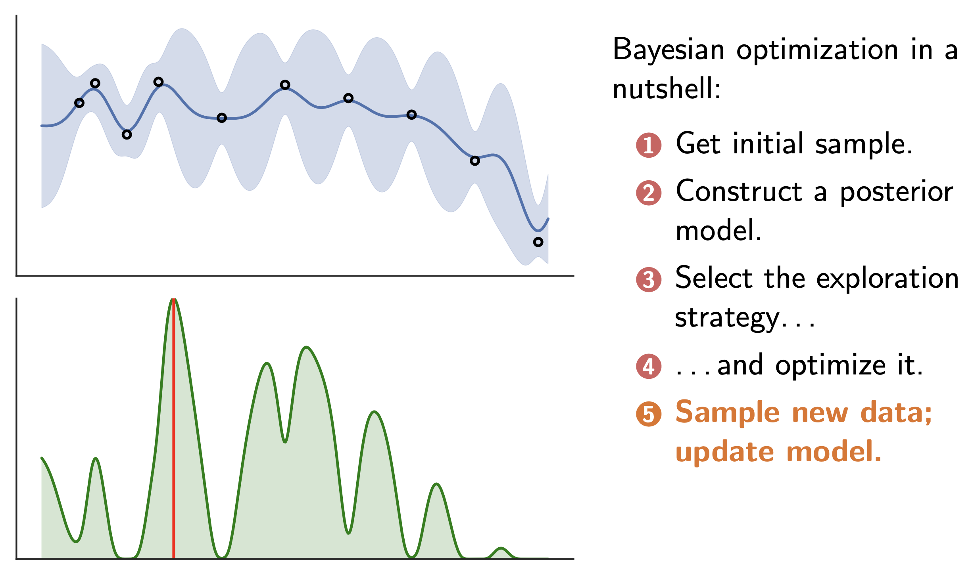
Bayesian Optimization
Figures credited to Miguel Hern ́andez-Lobato

Slide 9
Bayesian Optimization
Figures credited to Miguel Hern ́andez-Lobato

Slide 10
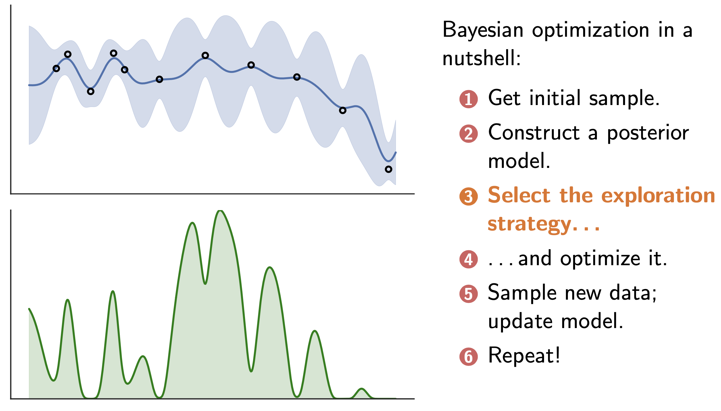
Bayesian Optimization
Figures credited to Miguel Hern ́andez-Lobato

Slide 11
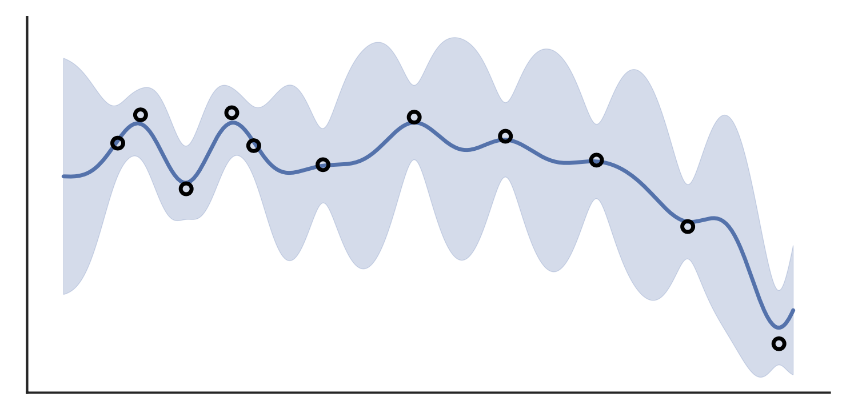
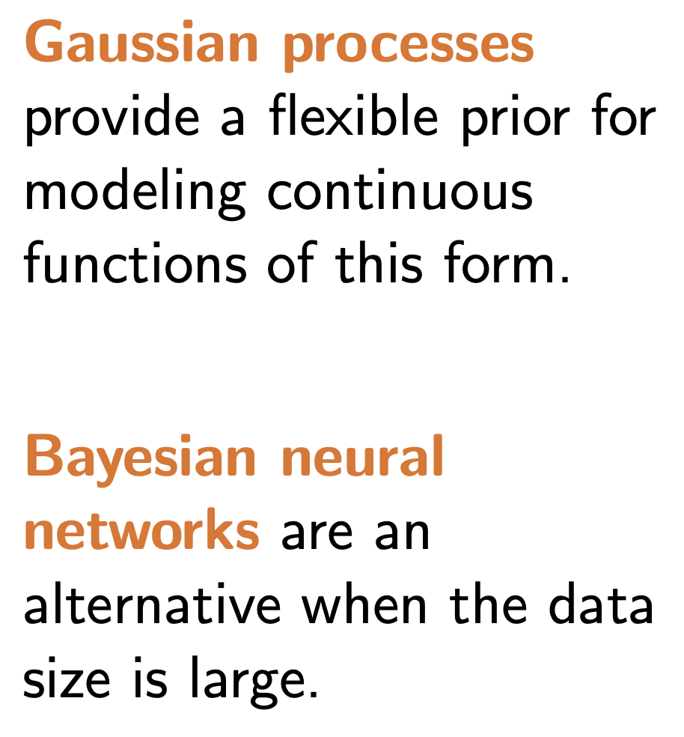
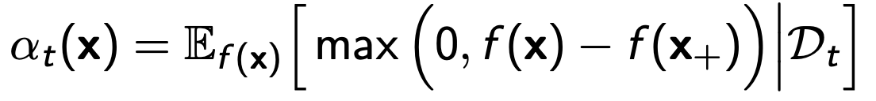

Bayesian Optimization
The question
What is the posterior model?
- We want to make prediction, while maintain an uncertainty measure
What is a proper exploration strategy?
- Expected improvement
- Entropy Gain

Slide 12

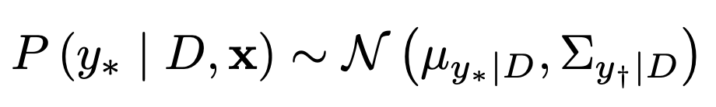

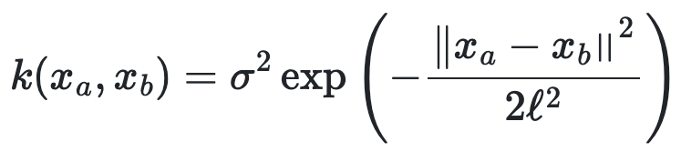
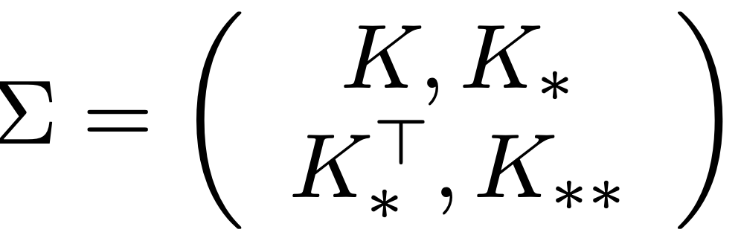
Bayesian Optimization
A bit about Gaussian Process
The Bayesian method to do prediction:
If everything is Gaussian,
Will not go into detail, but we need a kernel function K to measure the distance
The kernel functions measure the similarity between observed data points, and data points to predict.

Slide 13
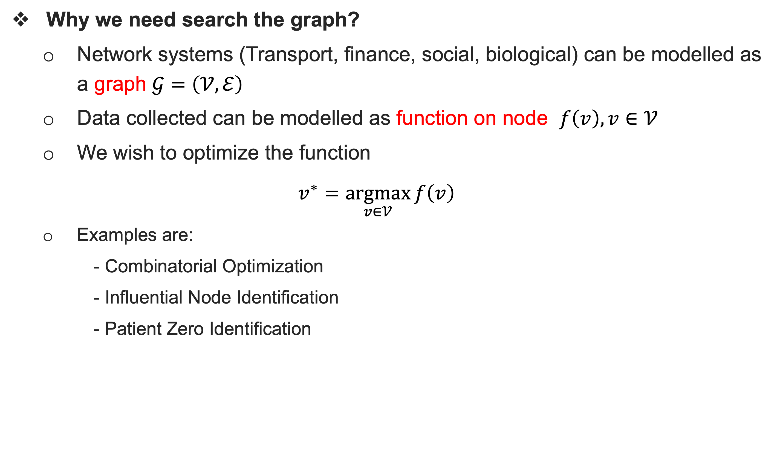
Bayesian Optimization on Graphs
Why we need search the graph?
Network systems (Transport, finance, social, biological) can be modelled as a graph $𝒢=\left(𝒱, ℰ\right)$
Data collected can be modelled as function on node $f\left(v\right), v∈𝒱$
We wish to optimize the function
$$v^{∗}=\underset{v∈𝒱}{argmax}{f\left(v\right)}$$
Examples are:
- Combinatorial Optimization
- Influential Node Identification
- Patient Zero Identification

Slide 14
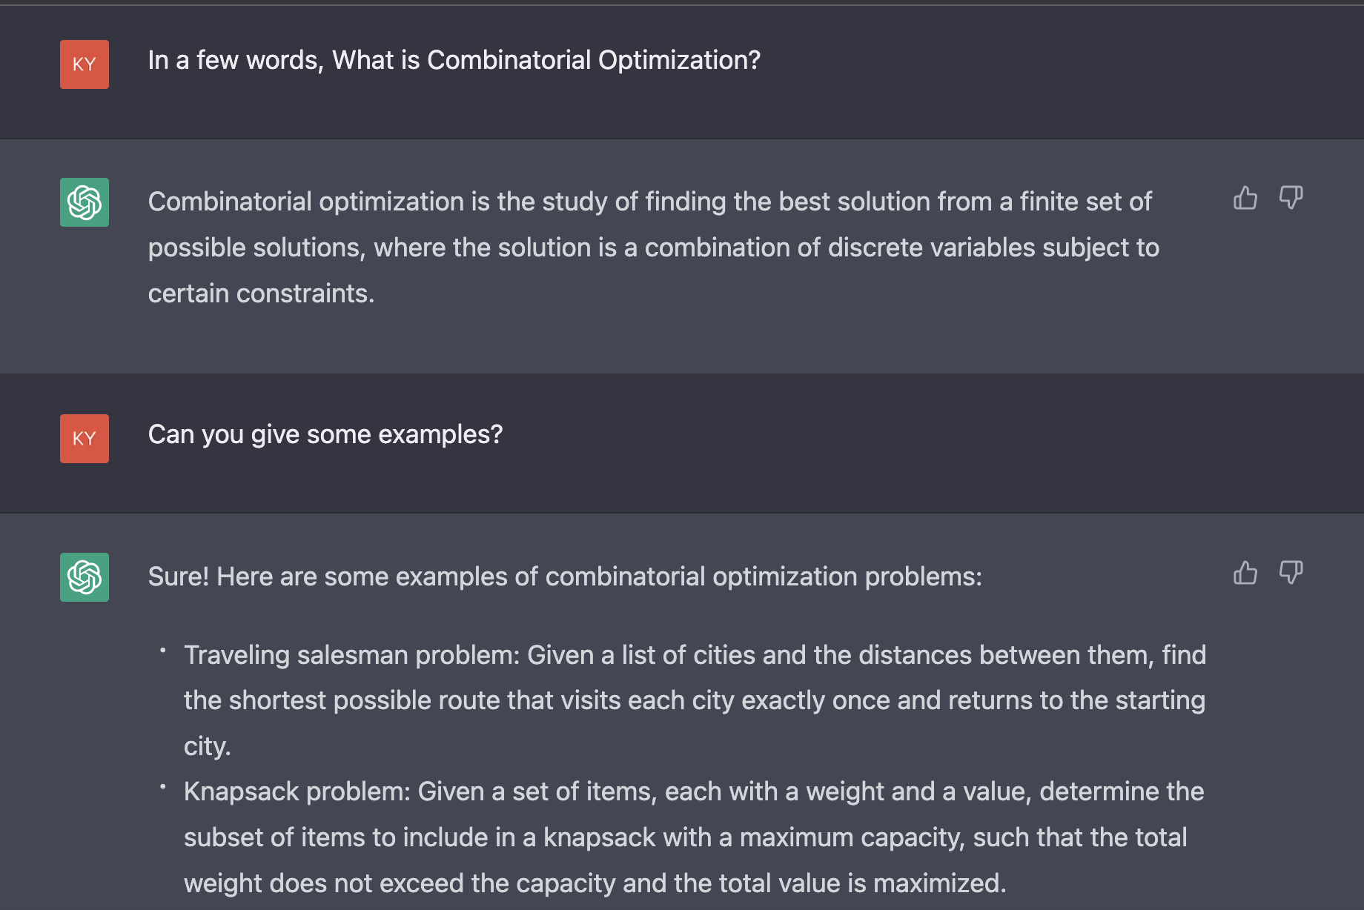
Combinatorial Optimization
Combinatorial Optimization
ChatGPT:

Slide 15

BO on Graphs- COMBO
Combinatorial Optimization
Another example: Neural Architecture Search:
Find best combination for :
Batch size:
$$c_{1}∈C_{1}=\{16,32,64\}$$
Optimizer:
$$c_{2}∈C_{2}=\left(AdaDelta, RMSprop, Adam\right)$$
Learning rate annealing:
$$c_{3}∈C_{3}=\{Constant, Annealing\}$$

Slide 16
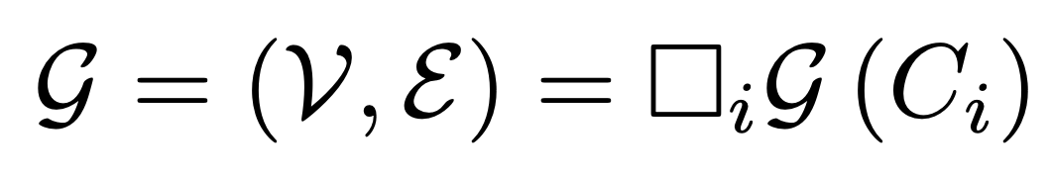
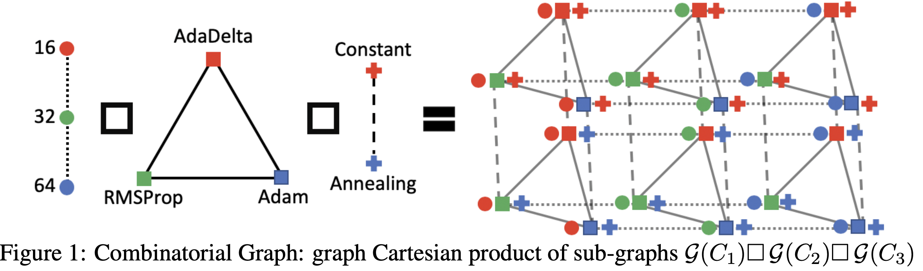

BO on Graphs- COMBO
The Combinatorial Graph [C. Oh et al., NeurIPS 2019]
Use the graph space to represent the Discrete Search Space
A subgraph per combinatorial variable, ${𝒢(C}_{i})=\left(𝒱, ℰ\right)$
Using graph Cartesian product to get the whole search graph:

Slide 17

BO on Graphs- COMBO
The Combinatorial Graph [C. Oh et al., NeurIPS 2019]
Using graph product to get the whole search graph:

Slide 18

BO on Graphs- COMBO
The Combinatorial Graph [C. Oh et al., NeurIPS 2019]
Using graph product to get the whole search graph:
Again Neural Architecture Search:
Batch size: $c_{1}∈C_{1}=\{16,32,64\}$;
Optimizer: $c_{2}∈C_{2}=\left(AdaDelta, RMSprop, Adam\right)$;
Learning rate annealing: $c_{3}∈C_{3}=\{Constant, Annealing\}$

Slide 19
BO on Graphs- COMBO
The Combinatorial Graph [C. Oh et al., NeurIPS 2019]
Interesting thing about this graph:
Nodes connected are only different by 1 combinatorial variable
Distance is exactly the Hamming distance (for a complete subgraph, > if not)

Slide 20
BO on Graphs- COMBO
Now you get this graph, how to search?
Bayesian Optimization!

Slide 21
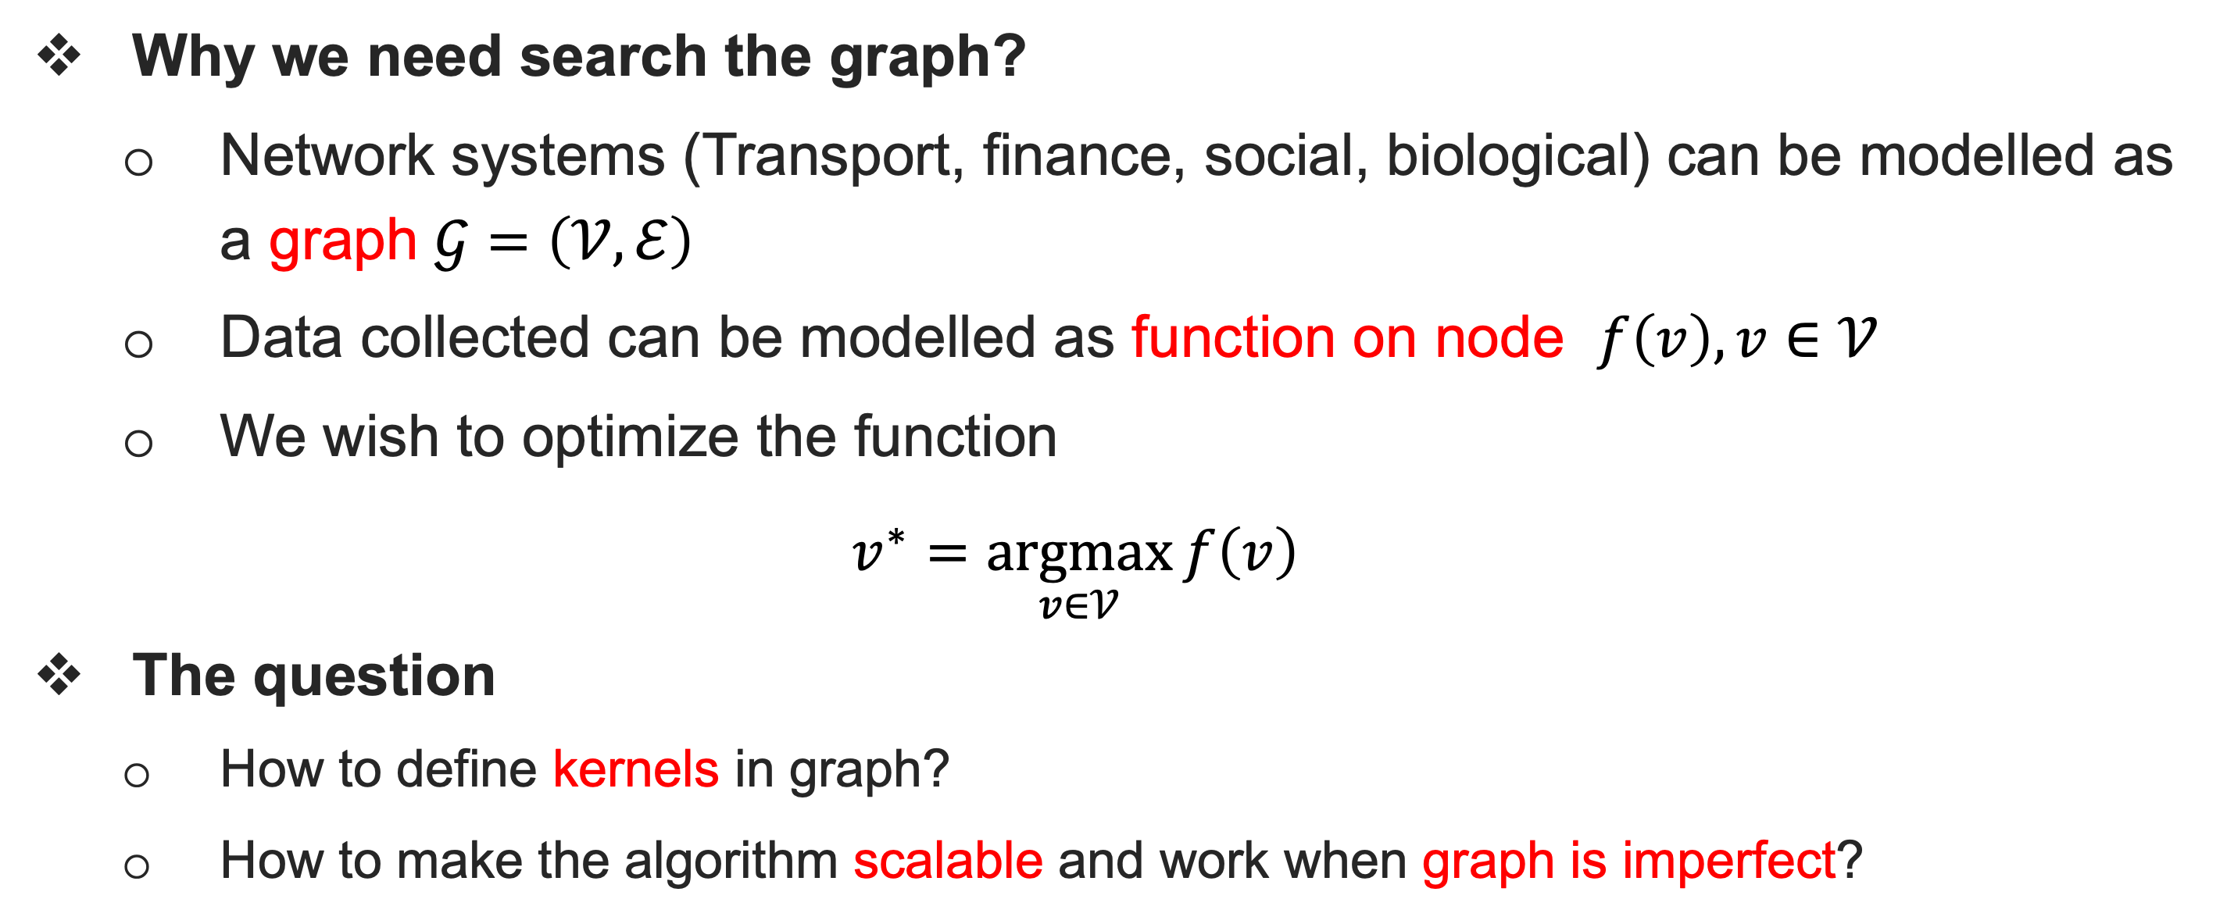
Bayesian Optimization on Graphs
Why we need search the graph?
Network systems (Transport, finance, social, biological) can be modelled as a graph $𝒢=\left(𝒱, ℰ\right)$
Data collected can be modelled as function on node $f\left(v\right), v∈𝒱$
We wish to optimize the function
$$v^{∗}=\underset{v∈𝒱}{argmax}{f\left(v\right)}$$
The question
How to define kernels in graph?
How to make the algorithm scalable and work when graph is imperfect?

Slide 22
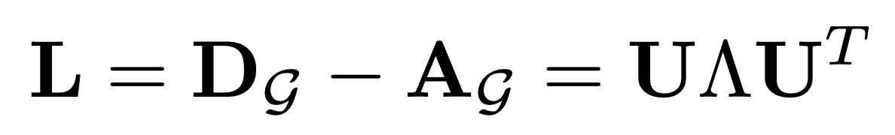
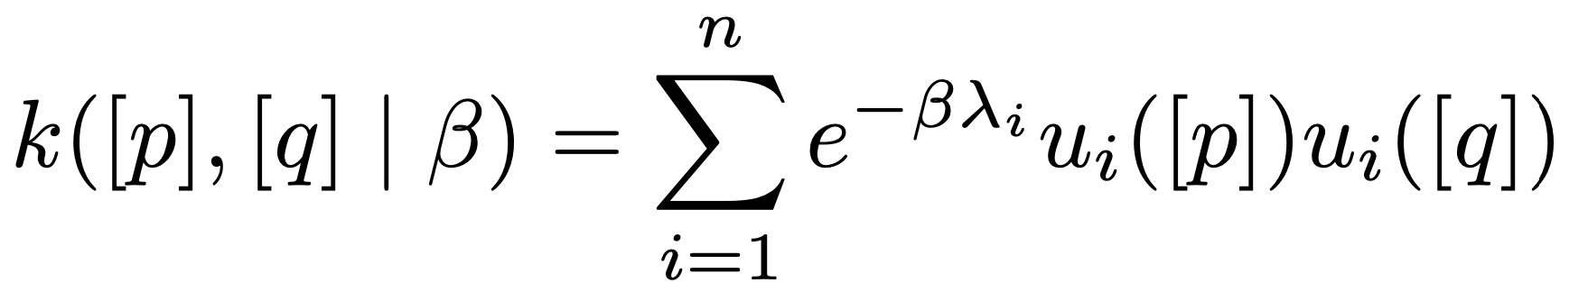
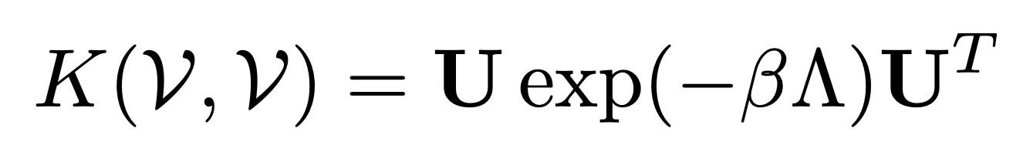
BO on Graphs- COMBO
Diffusion Kernels [R. I. Kondor et al., ICML 2002]
Purpose: formalize a smooth search space by data interpolation and extrapolation
A graph diffusion kernel
Eigensystem for Laplacian matrix
Diffusion kernel:
In Matrix form:
Take-home Message
The kernel is a similarity measurement of the distance between 2 nodes p and q

Slide 23
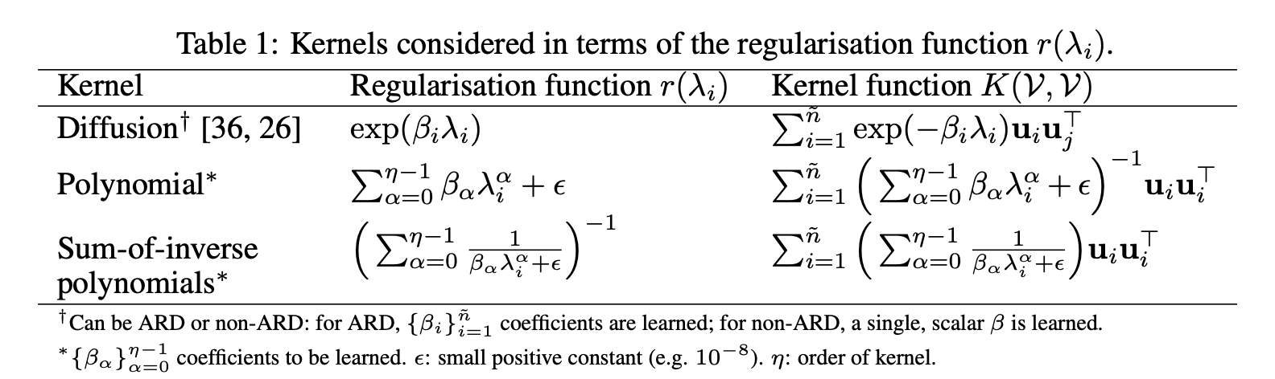
BO on Graphs- COMBO
Other Kernels
Purpose: formalize a smooth search space by data interpolation and extrapolation
Take-home Message
The kernel is a similarity measurement of the distance between 2 nodes p and q

Slide 24
Now, search the space by BO!

Slide 25
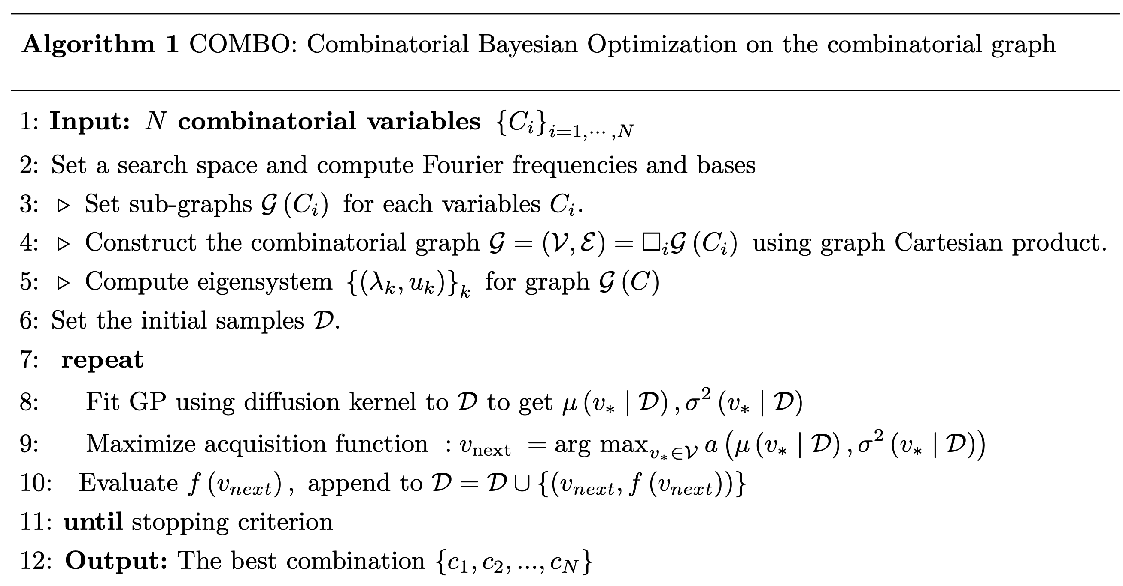
COMBO – a simplified version

Slide 26
Question 2: However, real-world Graphs are Giant, even not fully observable. How to search in such a space?

Slide 27
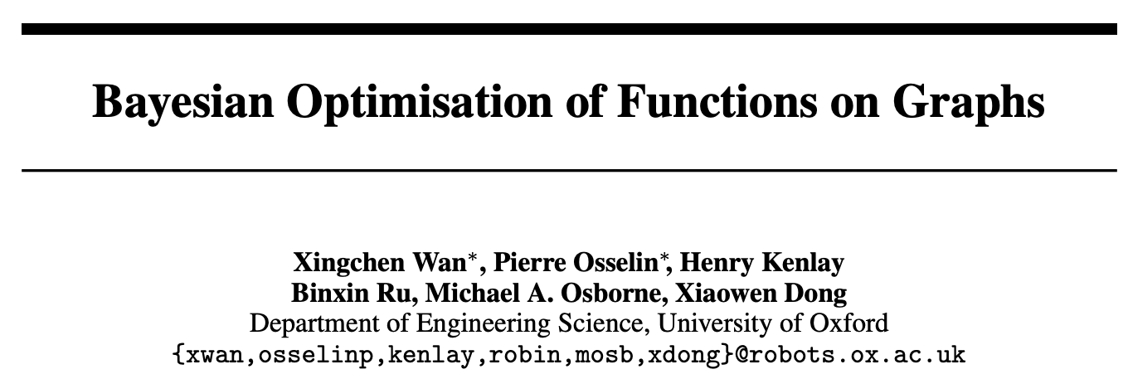

Slide 28

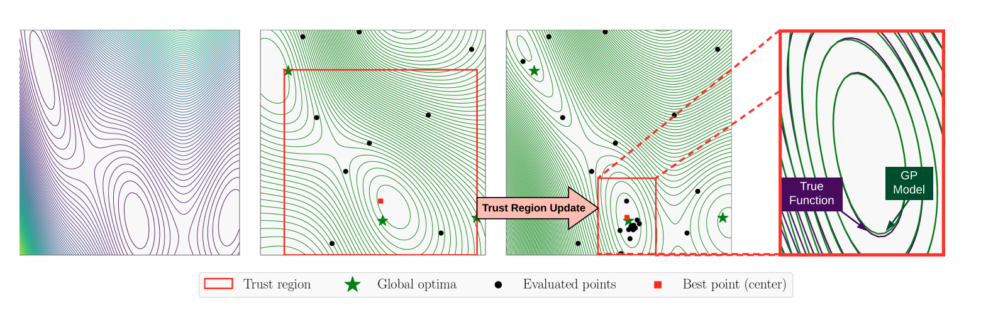
Trust-region Bayesian Optimization
Local Optimization
Instead of searching for the global optima, search the local instead

Slide 29
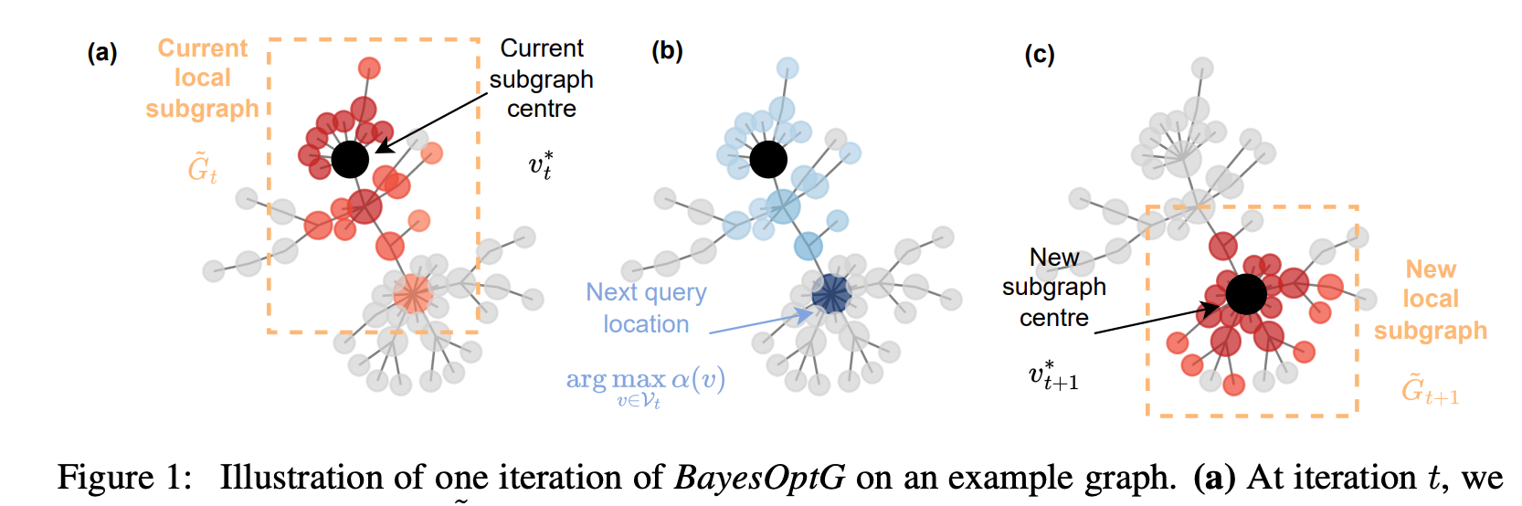
A Similar Idea works for Graphs
Local Optimization
Instead of searching for the global optima, search the local instead

Slide 30
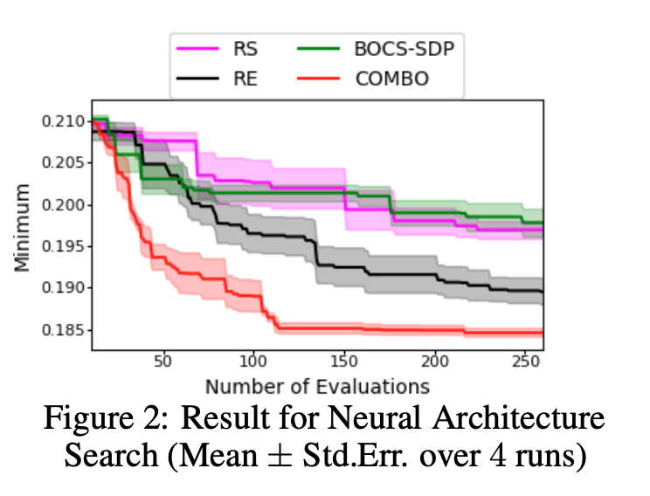
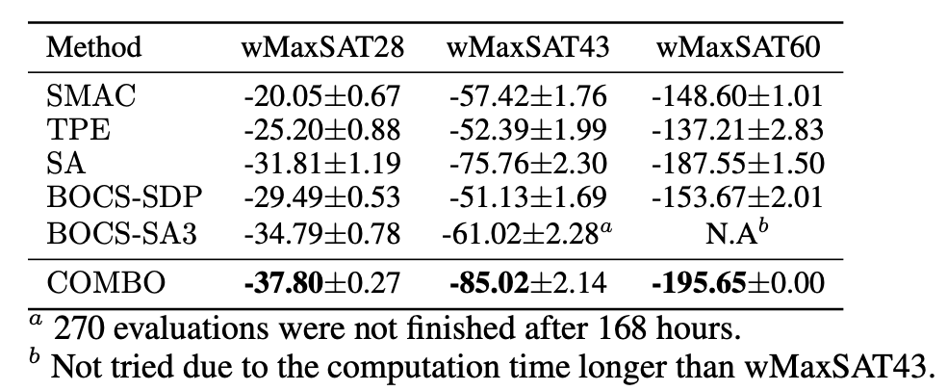
Experiments
Combinatorial Optimization
Baselines (Random Search, Regularized Evolution, BOCS with Linear Regression)
Tasks:
- Weighted Maximum Satisfiability
- Neural Architecture Search

Slide 31
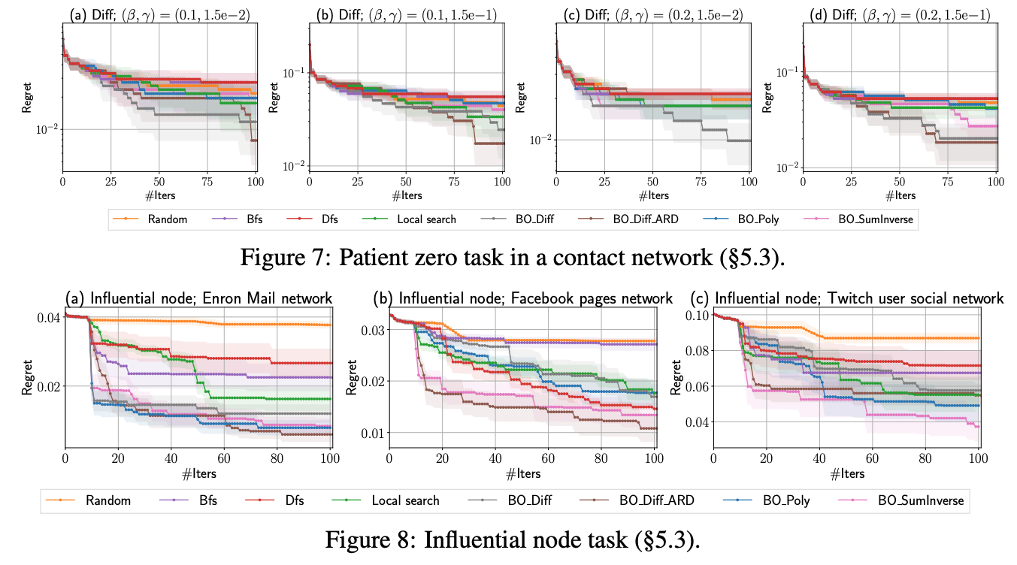
Experiments
Graph Searching Problem
Baselines (DFS, BFS, Local Search)
Tasks: Patient Zero / Influential Node Identification

Slide 32
Thanks for your attention!

